Slide 1

Gender Classifier for Python
By Matthew Weirath

Slide 2
Overview
Getting Started
Downloading the package
Extracting the package
Pointing to Directory in Spyder
Using the package
Creating a new model
Using new model

Slide 3
Getting Started
This demonstration will use Python 3.x and Spyder from the Anaconda Python distribution
This will work with any Python interface, however Anaconda distribution is recommended and can be downloaded here:
https://www.anaconda.com/download/

Slide 4
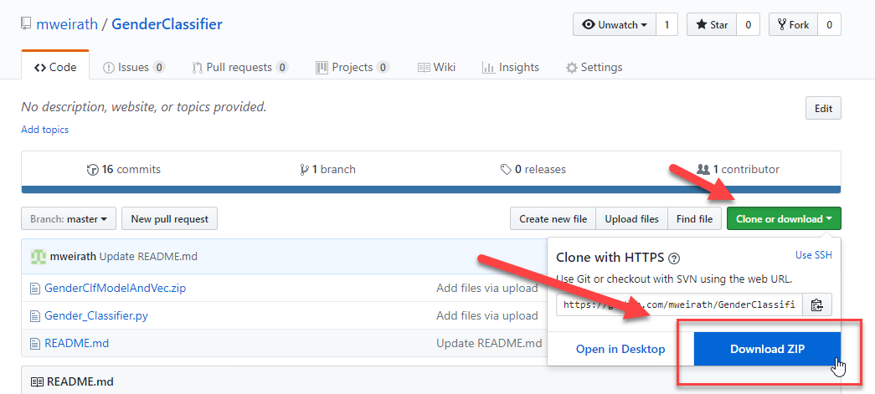
Downloading the package
The package is publicly available at the following GitHub address:
https://github.com/mweirath/GenderClassifier
Select Clone or Download and then Download Zip

Slide 5
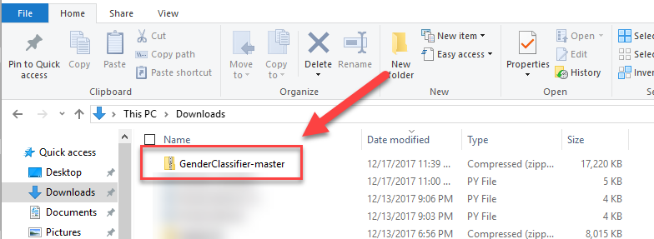
Extracting the Package
Go to your downloads folder and extract the file to your choice location:

Slide 6
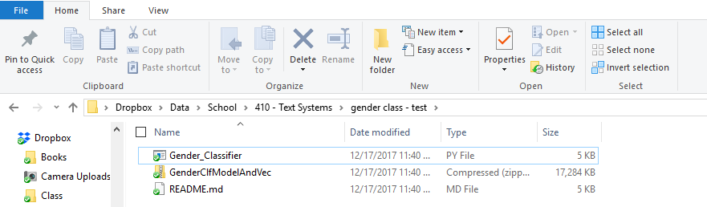
Extracting the Package (cont.)
In this case I extracted the package to my, but feel free to use whatever folder you like:
Dropbox > Data > School > 410-Text Systems > gender class – test folder

Slide 7
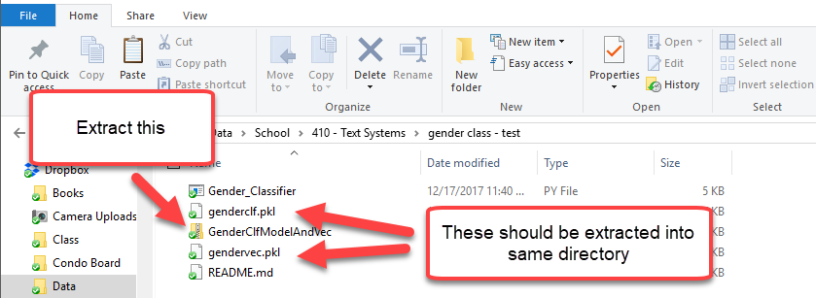
Extracting the Package (cont.)
Next extract the GenderClfModelAndVec.zip file into the same directory.
This should create:
Genderclf.pkl & gendervec.pkl

Slide 8
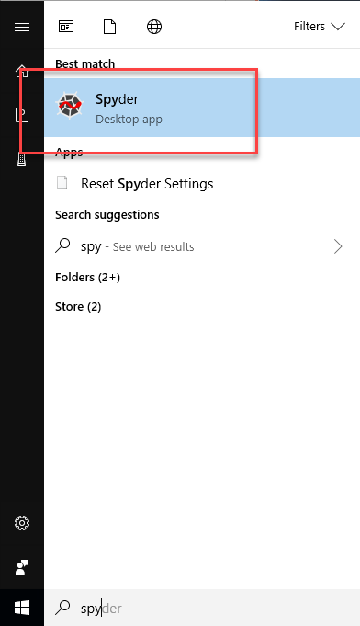
Pointing to Directory in Spyder
Next open Spyder (or other Python interface)

Slide 9
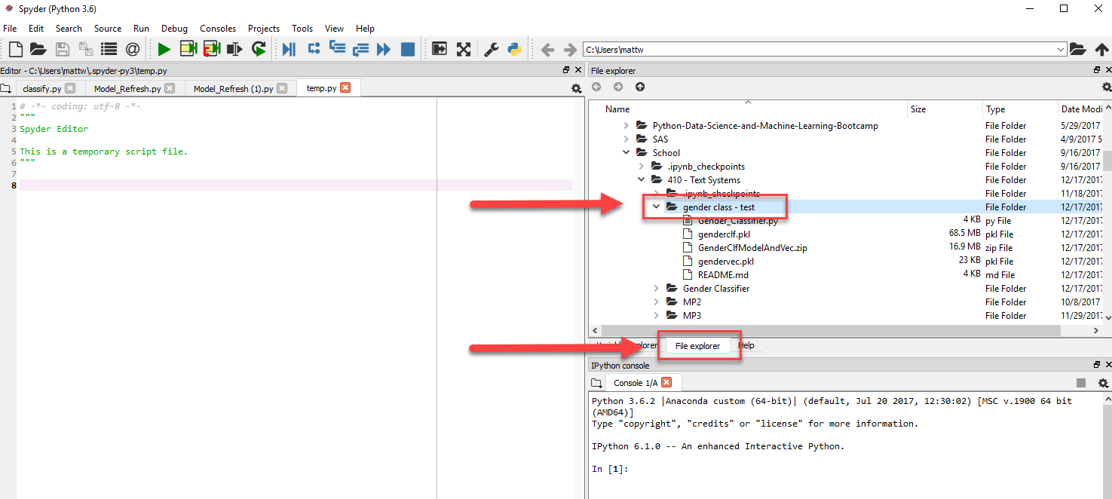
Pointing to Directory in Spyder (cont.)
Using the file explorer file the directory you created with the extracted files

Slide 10
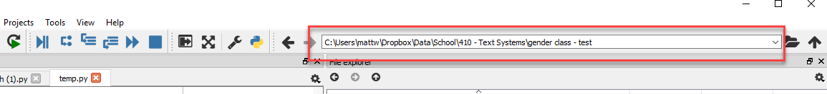
Pointing to Directory in Spyder (cont.)
Double click on the folder to move the directory into the navigation bar:

Slide 11
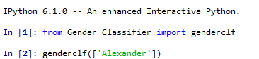
Using the package
To predict a gender go to the iPython Console and import the package:
from Gender_Classifier import genderclf
Then to determine gender of a name use the following:
genderclf([‘Alexander’])

Slide 12
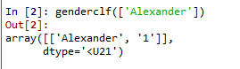
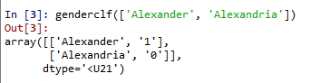
Using the package (cont.)
This will generate an array with a binary result of 0(Female) or 1(Male)
Multiple Name can be fed in an array format

Slide 13

Create a new model
To train a new model you need to import the updatemodel module
from Gender_Classifier import updatedmodel
You would then set a begin date, end date, and model name:
For example Generation X names 1961-1981
updatedmodel(begindate=1961, enddate=1981, modelname='genx’)

Slide 14
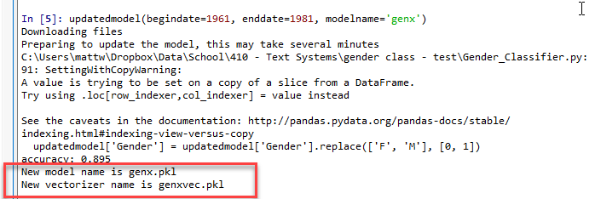
Create a new model (cont.)
This will download new files from the Social Security Administration and build a new model.
The model name and vectorizer names will be given at the end of the process

Slide 15
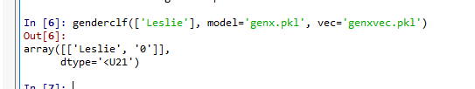
Using new model
The default model can be overridden using model and vec set to the new pickled file names
genderclf(['Leslie'], model='genx.pkl', vec='genxvec.pkl’)
*Note – Due to variances and differences in datasets it is not recommended to use different models and vectorizers

Slide 16
Next Steps
Ensembling methods to work better on unseen data
Generating measures around predictions
Incorporating foreign name sources
Build new feature sets

Slide 17
Thank You!

